Slide 1
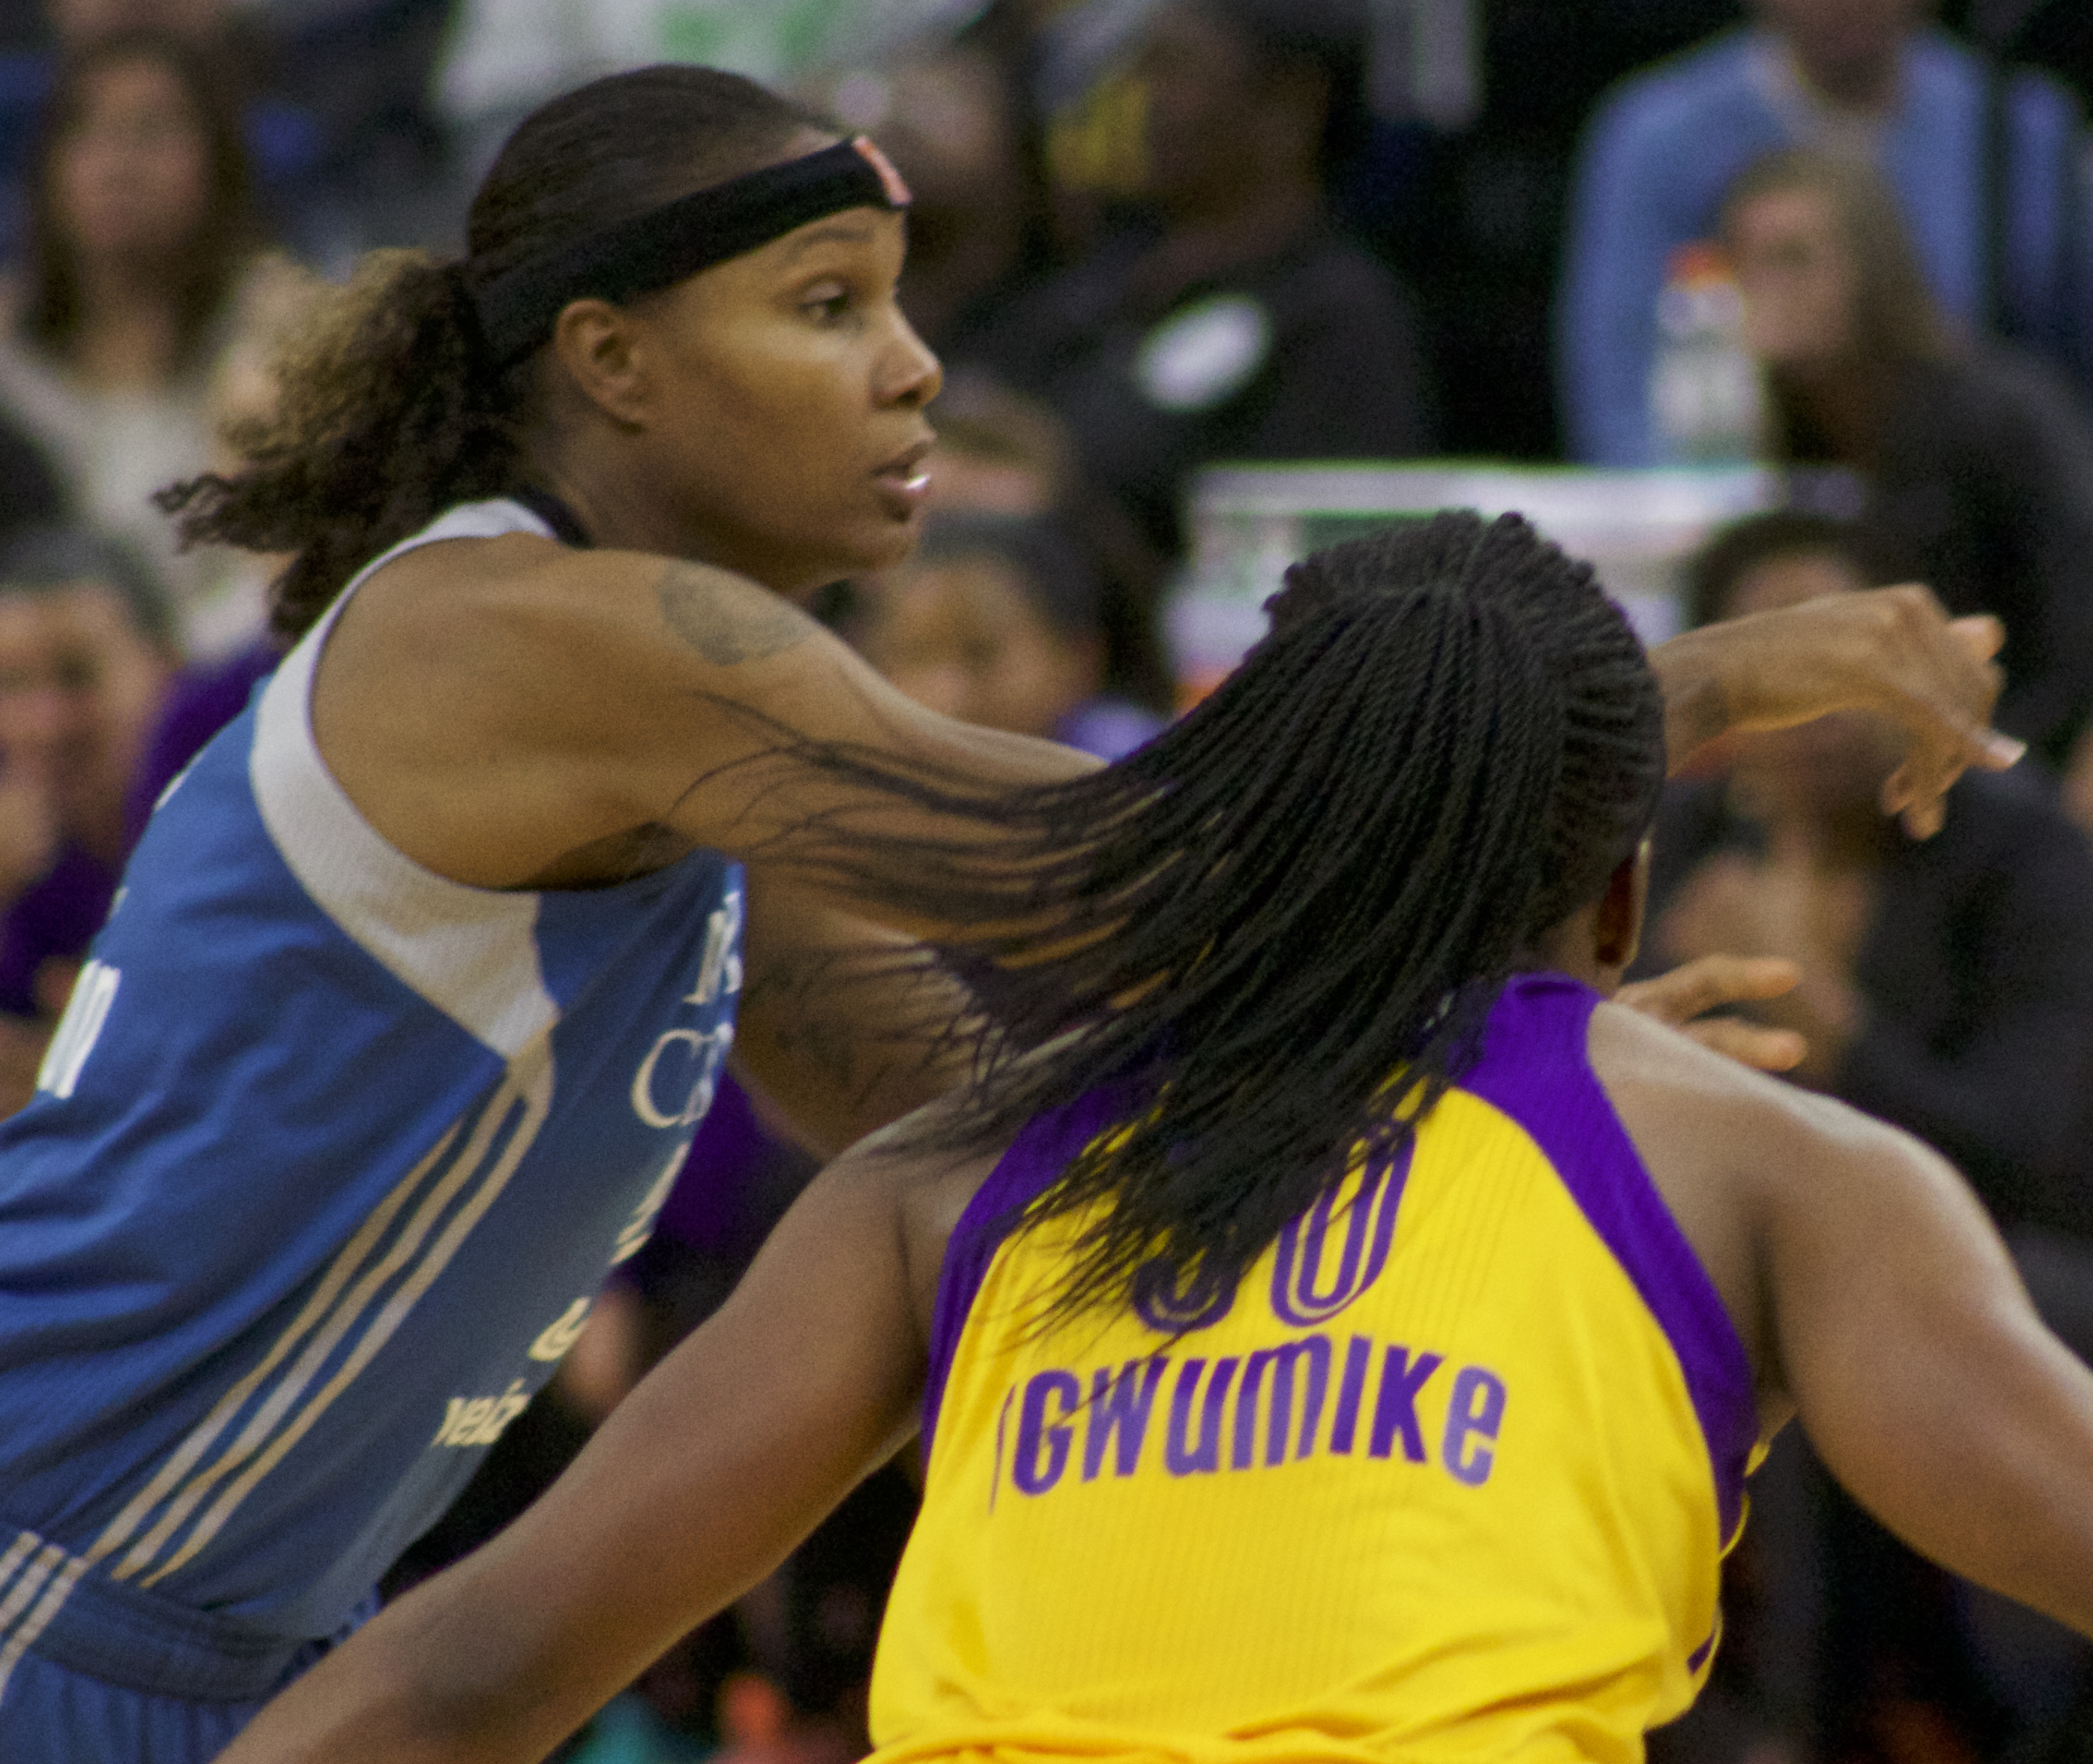
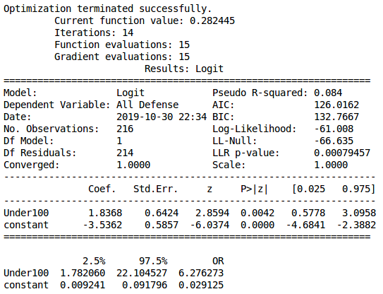
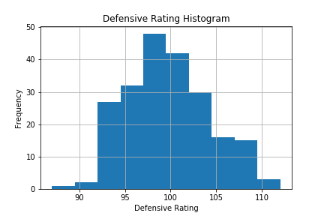
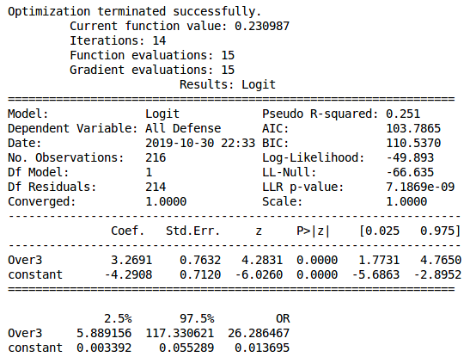
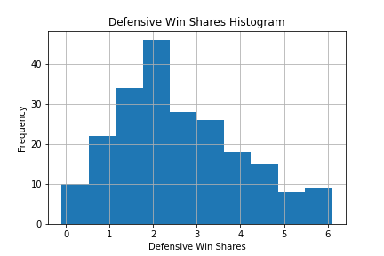


Non-Cognitive Predictors of Student Success:
A Predictive Validity Comparison Between Domestic and International Students
Non-Cognitive Predictors of Student Success:
A Predictive Validity Comparison Between Domestic and International Students
Do Advanced WNBA Defensive Stats Predict Making the All-Defensive Team Chosen by the Coaches?
Players rated well defensively by the numbers have better odds of being chosen as top defenders by the coaches.
Charlie Danoff
INTRO: In basketball a made shot is an easily measurable offensive measure, but individual defensive metrics are harder to quantify. To address that, Defensive Rating (a measure of how many points per 100 possessions are allowed when that player plays) and Defensive Win Shares (how many wins the player added based on their defensive play) were created. But do they align with what coaches judge as good individual defenders?
METHODS: As a proxy for how coaches evaluate defenders, I chose WNBA All-Defensive first and second teams selected by the league head coaches. Quantitative metrics were taken from www.stats.wnba.com for the 2018 and 2019 seasons for players with more than 250 minutes. I ran a binary logistic regression to see whether or not Defensive Ratings or Defensive Win Shares significantly increased the odds of being on the All-Defensive First of Second Teams.
RESULTS: Players with a Defensive Rating under 100 had statistically significantly better odds of being on one of the All-Defensive teams, as did players with more than 3 Defensive Win Shares. Thus, the quantitative measures appear to align with the qualitative opinion of the coaches. At least for the top ten players. This is an encouraging development in measuring defensive impact and bodes well for the future of basketball analytics. Perhaps in the future teams can follow the lead of baseball and devise analytic based defensive strategies.
www.danoff.org/ball
Take a picture to download the full poster
Photo of Rebekkah Brunson guarded by Nneka Ogwumike "Brunson 20161009" by Susan Lesch via Wikimedia Commons. Available Under the Creative Commons 0 Dedication. https://commons.wikimedia.org/wiki/File:Brunson_20161009.jpg
Notes:
Notes:
In Powerpoint, click View > Guides
Keep text within gutter guides.
Author list: Don’t split names onto two lines (e.g., “Jimmy [break] Smith”). If that happens, use a new line, unless you need the space. Bold the first names of anybody who’s presenting in person.
Intro/methods/result: Do not drop below font size 28, but if you have extra space, jack up the font size until the space is full.
Do not use color in the sidebars except in graphs/figures. It’ll pull attention from the center and slow interpretation for passersby.

